Slide 1

WELCOME

Slide 2
Requirements
Backend
Java Development Kit (JDK)
Java IDE (we are using Eclipse here, but any Java IDE will work)
Maven
MySQL Database and MySQL Workbench
FrontEnd
Npm
Angular Cli
Visual Studio Code

Slide 3
Project overview
Show a list of products
Search products by product name
Add products to shopping cart (CRUD)
Shopping cart check out
User login/logout security
Track previous orders for logged in user

Slide 4
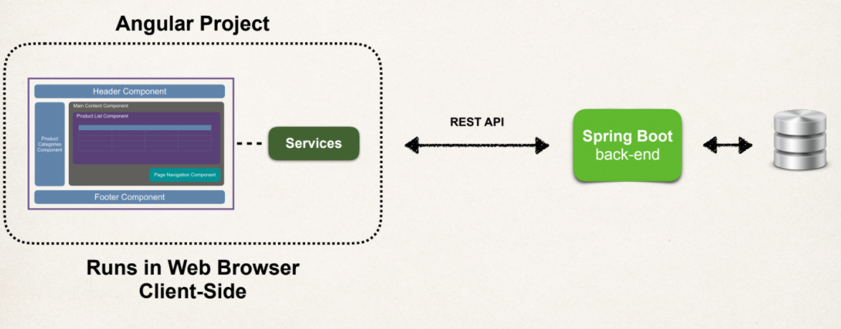
Application Interaction

Slide 5
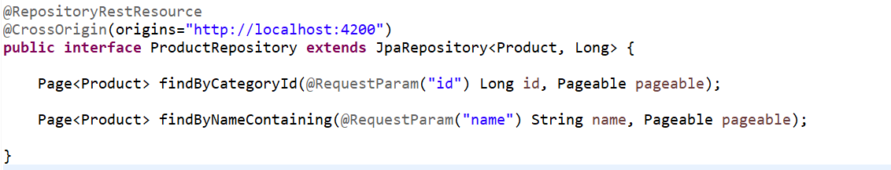
Rest End Points
Create Repository
Spring Data REST will scan your project for JpaRepository.
Expose REST APIs for each entity type for your JpaRepository.
By default, Spring Data REST will create endpoints based on entity type.
Simple pluralized form
First character of Entity type is lowercase
Then just adds an “s” to the entity
products

Slide 6
Rest API
Spring Data REST will expose these endpoints for free
Http Methods |  | CRUD Action
POST | /products | Create new product
GET | /Products | Read List of products
GET | /products/{id} | Read a single product
PUT | /products/{id} | Update an existing product
DELETE | /products/{id} | Delete an existing product

Slide 7
Development Process
Angular Frontend
Create Angular project
Create Angular component
Develop TypeScript class
Create Angular service to call REST APIs
Update Angular component to subscribe to data from Angular service
Display the data in an HTML page
Add CrossOrigin support to Spring Boot app

Slide 8
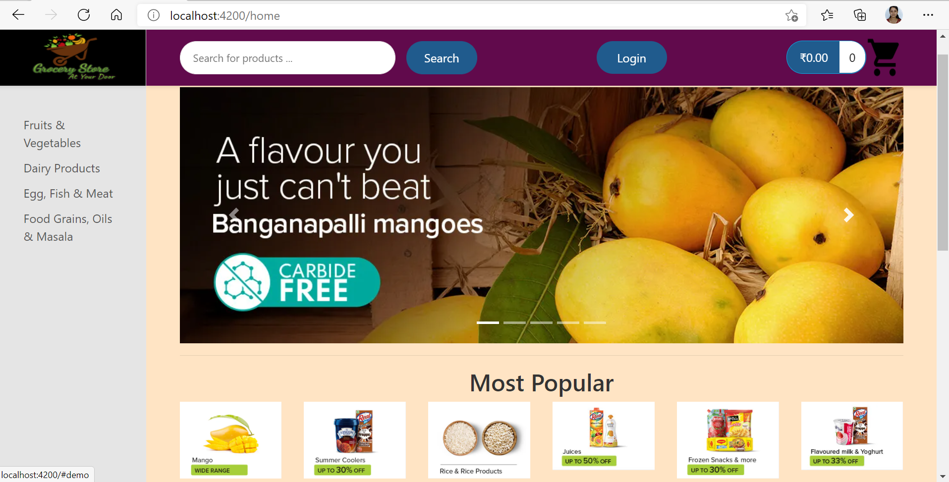
Home Page

Slide 9
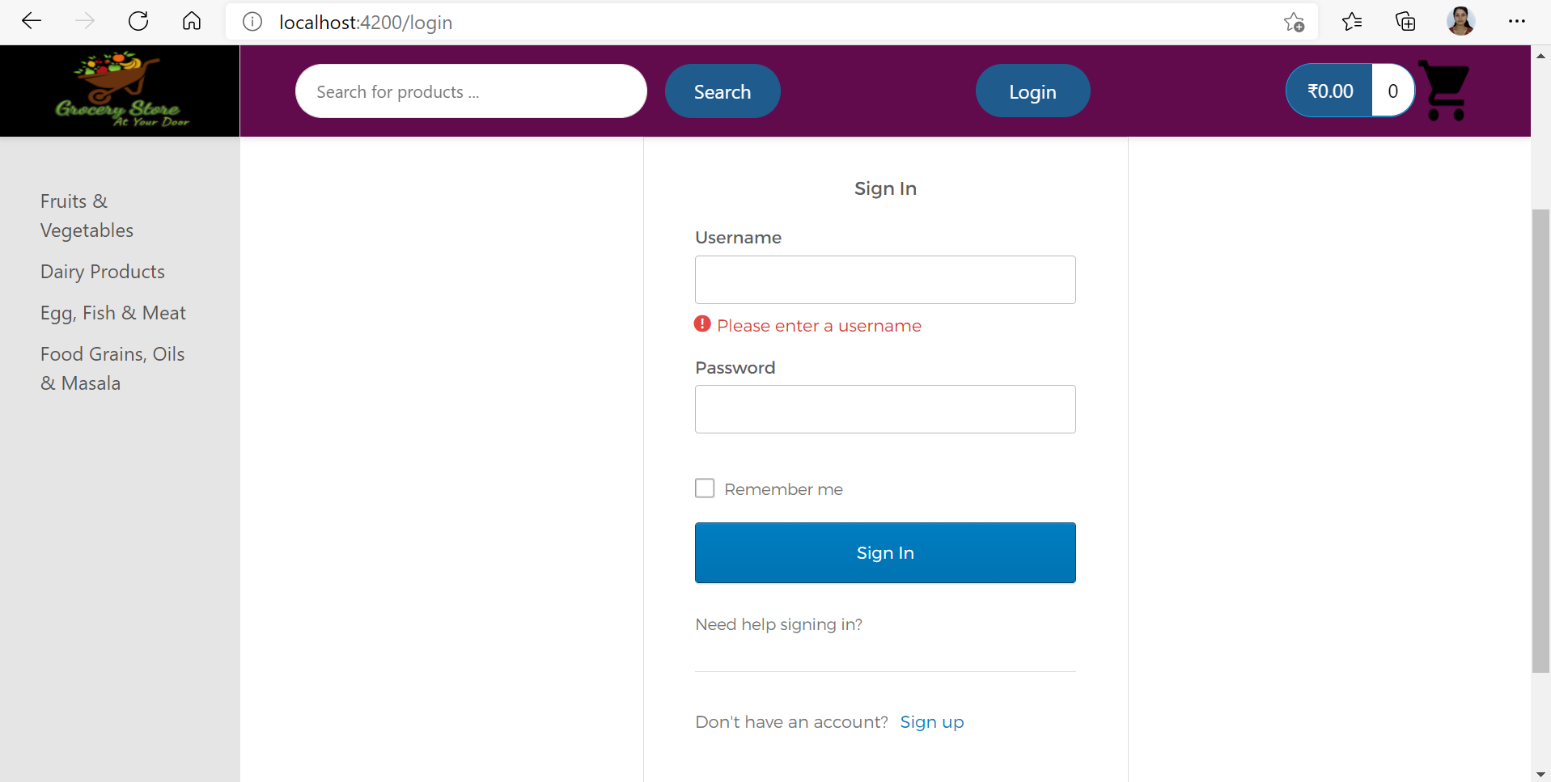
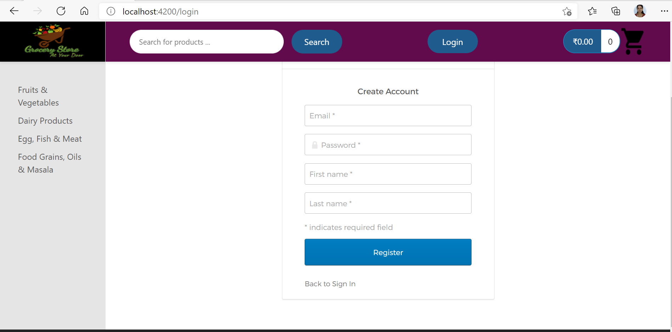
Login and Registration

Slide 10
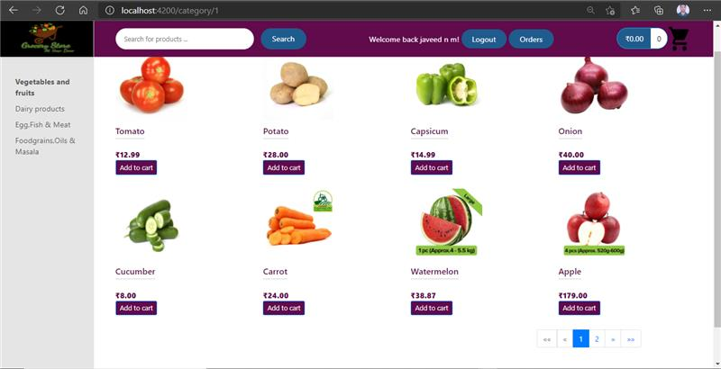
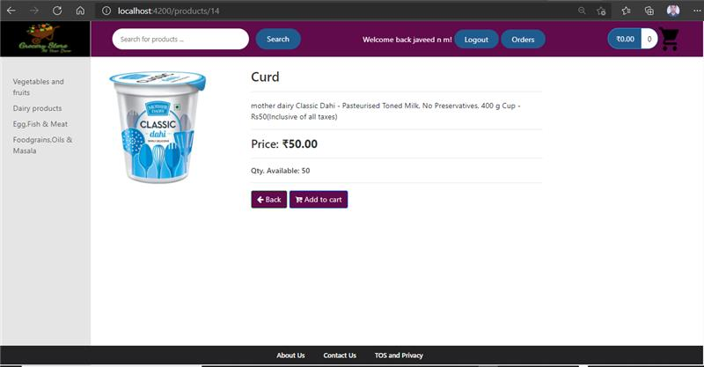
Product List and Product Details

Slide 11
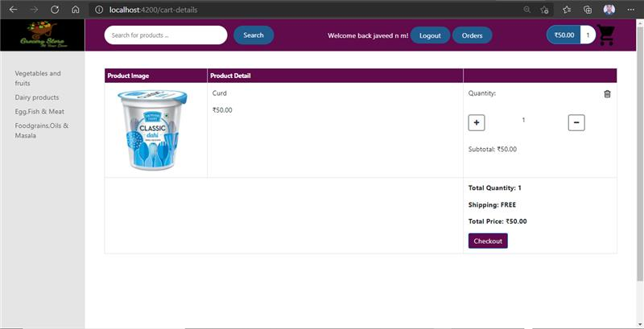
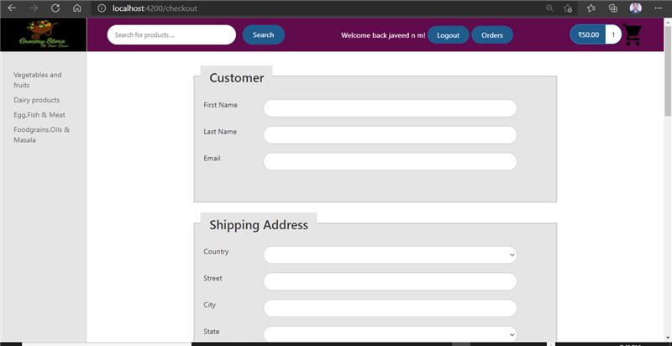
Cart Details and checkout form

Slide 12
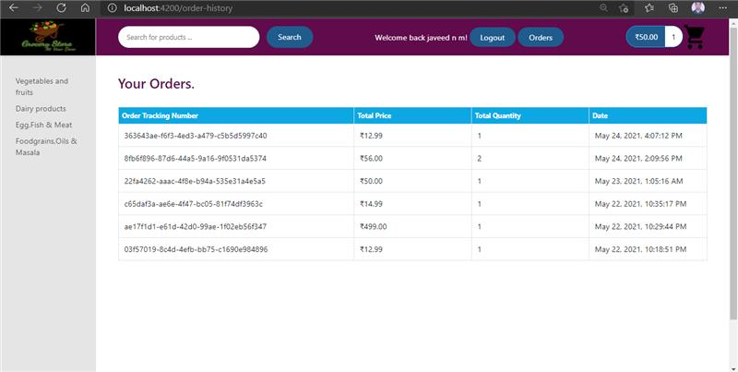
Order History

Slide 13
Future Enhancement
Login and Registration with other Authentication techniques
Adding different payment methods.
Enhancing UI

Slide 14
THANK YOU

Slide 15
Now time for app demo
Lets Go..!

